Slide 1

Vel Tech Rangarajan Dr. Sagunthala R&D Institute of Science and Technology
School of Computing
Department of Computer Science and Engineering
10211CS224 / FULL STACK APPLICATION DEVELOPMENT (JAVA)
PROJECT REVIEW : MILESTONE PROJECT – 1
Date: 04-03-2026
Automated Quiz Engine with PDF Certification Generation
SDG: SDG 4 – Quality Education
Presented By:
VINAY SINDAMKAR – VTU25539 – 23UECS0608.
Courses Handling Faculty:
Dr. S . HEMAMALINI – M.E., Ph.D.,

Slide 2
INTRODUCTION
Background of the problem:
Traditional quizzes lack automation and certification features.
Why this project is important:
It streamlines learning assessments and validates knowledge instantly.
Real-world relevance:
Useful for online courses, corporate training, and skill evaluations.
Brief overview of the system:
An automated quiz engine that generates results and issues PDF certificates
1
2
3
4
5
6
7
8
9

Slide 3
PROBLEM STATEMENT
In many educational institutions and training platforms, quizzes are conducted manually or using basic systems that lack automation. This creates difficulties in managing users, organizing quizzes, evaluating answers, and generating results efficiently. Manual evaluation consumes time and may lead to calculation errors. Generating certificates separately also increases administrative workload. There is a need for a secure, reliable, and fully automated quiz system that can manage users, conduct quizzes, calculate scores instantly, and generate certificates automatically. Such a system improves accuracy, saves time, and enhances overall performance.
1
2
3
4
5
6
7
8
9

Slide 4
OBJECTIVES
1.To design and develop a web-based Automated Quiz Engine with secure user authentication and quiz management features.
2. To implement automatic quiz evaluation and PDF certificate generation with accurate score calculation.
1
2
3
4
5
6
7
8
9

Slide 5
PROPOSED SYSTEM
1.The proposed system is a web-based Automated Quiz Engine that manages users, quizzes, evaluation, and certificate generation in one platform
2. It allows users to register and attend quizzes easily.
3. Admin can create and manage quizzes and questions.
4. The system checks answers and calculates marks automatically.
5. It generates certificates for students who pass the quiz.
6. It reduces manual work and saves time.
7. It avoids mistakes in result calculation.
8. It is faster and more efficient than manual systems.
1
2
3
4
5
6
7
8
9

Slide 6
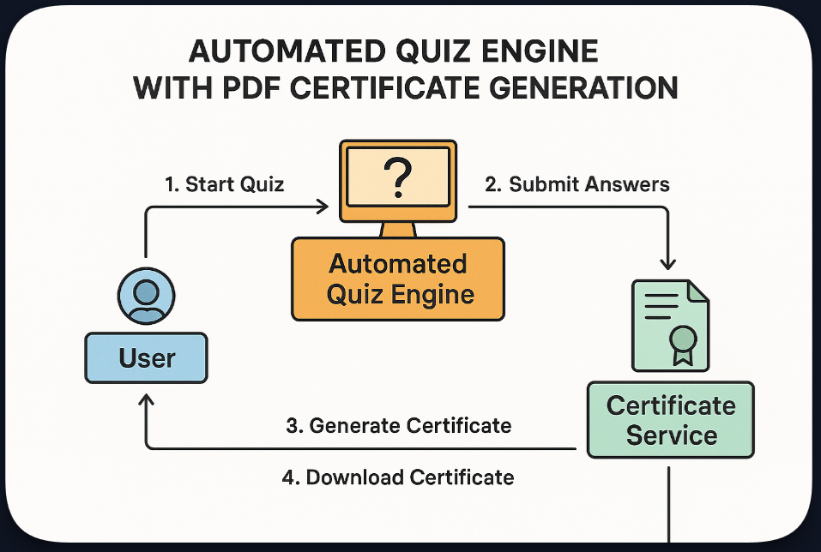
PROPOSED SYSTEM ARCHITECTURE
1
2
3
4
5
6
7
8
9

Slide 7
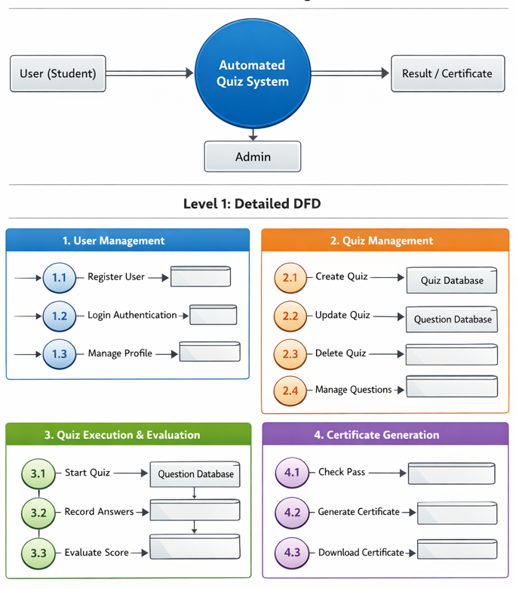
WORKFLOW
(Add dataflow diagram)
1
2
3
4
5
6
7
8
9

Slide 8
TECHNOLOGIES USED
Frontend:
1.HTML5
2.CSS3
3.Javascript
Backend:
1.Java Spring Boot
Tools:
1.Eclipse IDE
Software Requirements:
1.Windows / Mac
2. Web Browser
1
2
3
4
5
6
7
8
9

Slide 9
MODULE DESCRIPTION
Module 1: User Management
Handles user registration, login, and profile management with secure authentication.
Module 2: Quiz Management
Allows Admin to create , update , delete , quizzes and manage questions.
Module 3: Quiz Execution & Evaluation
Conducts quizzes , record answers, and automatically calculates scores.
Module 4: Certificate Generation
Generates and downloads PDF certificates for users who pass the quiz.
1
2
3
4
5
6
7
8
9

Slide 10
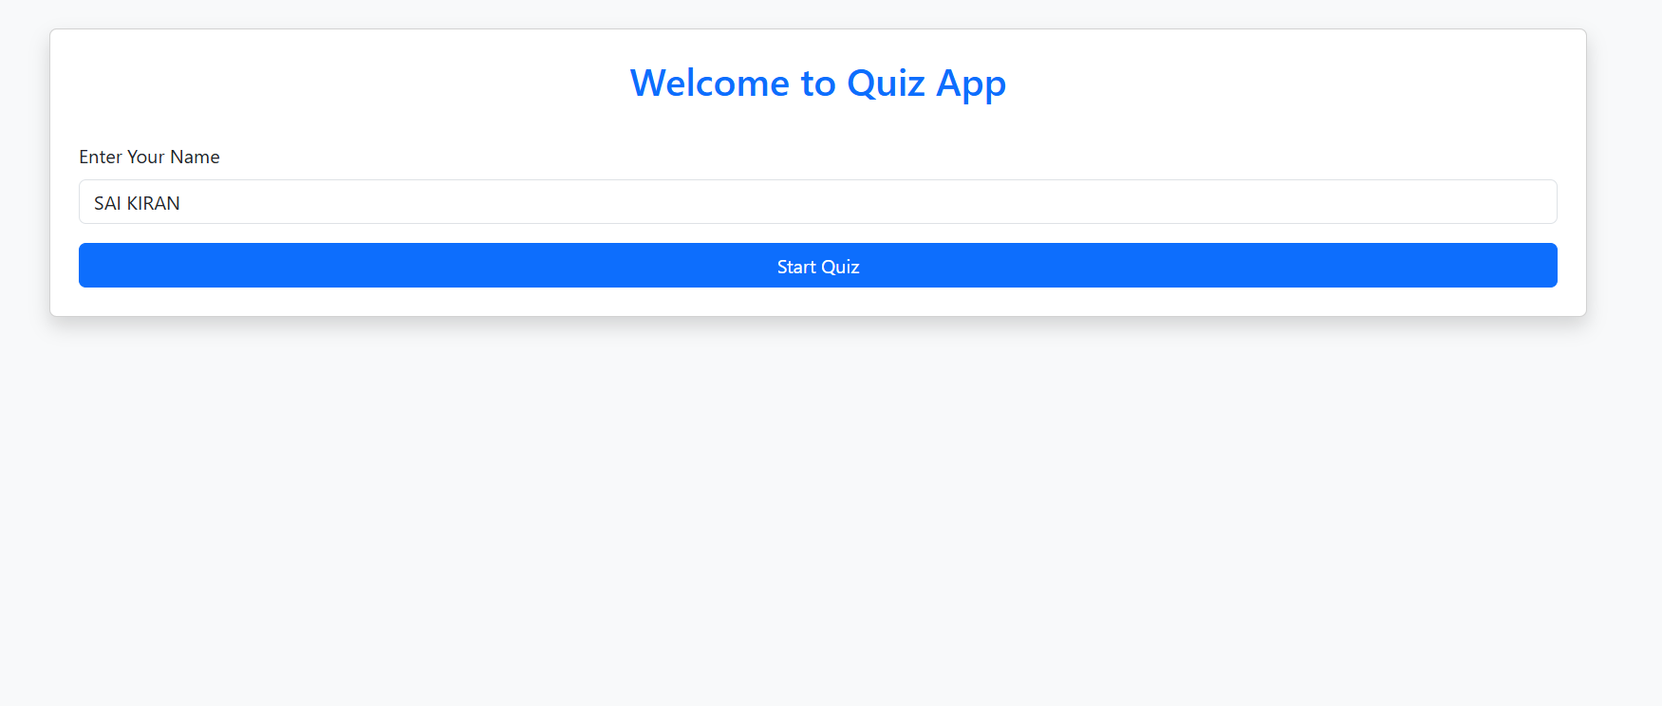
IMPLEMENTATION SCREENSHOTS
Login Page / Home Page:
1
2
3
4
5
6
7
8
9

Slide 11
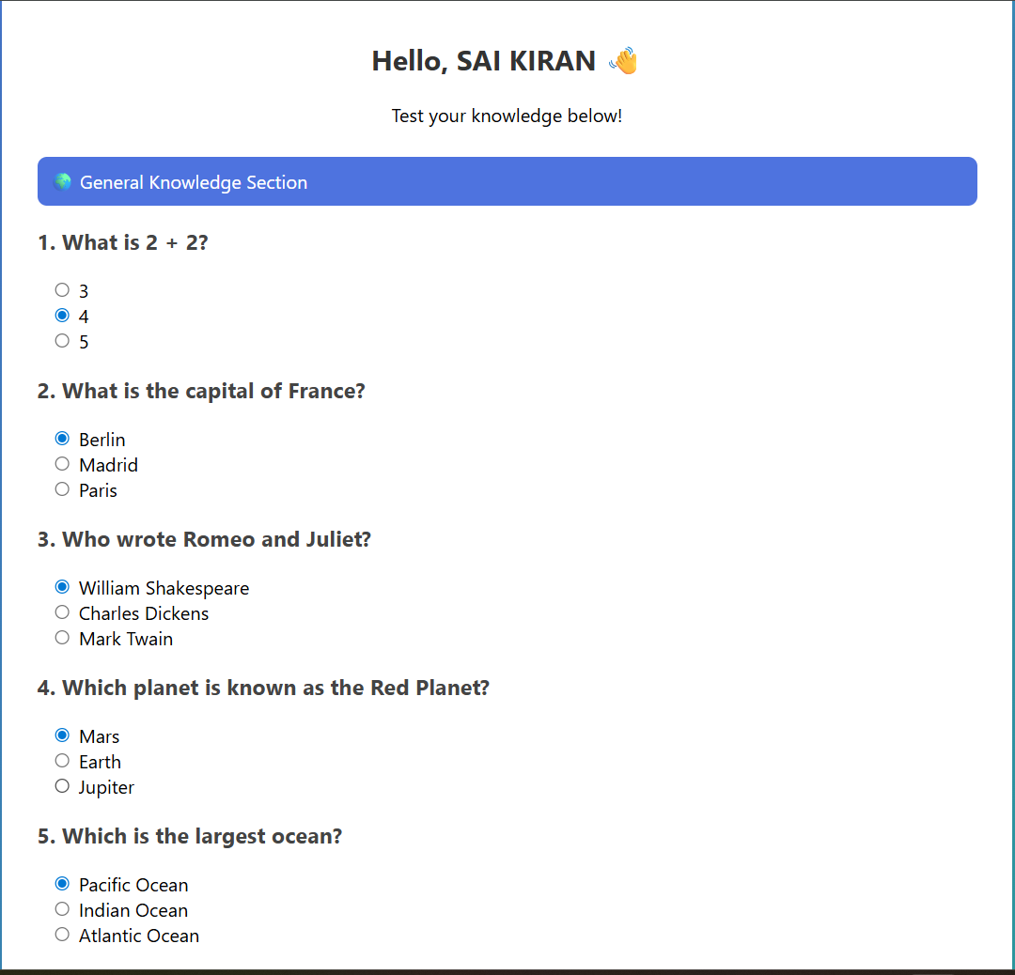
IMPLEMENTATION SCREENSHOTS
Main Page :
1
2
3
4
5
6
7
8(A)
9

Slide 12
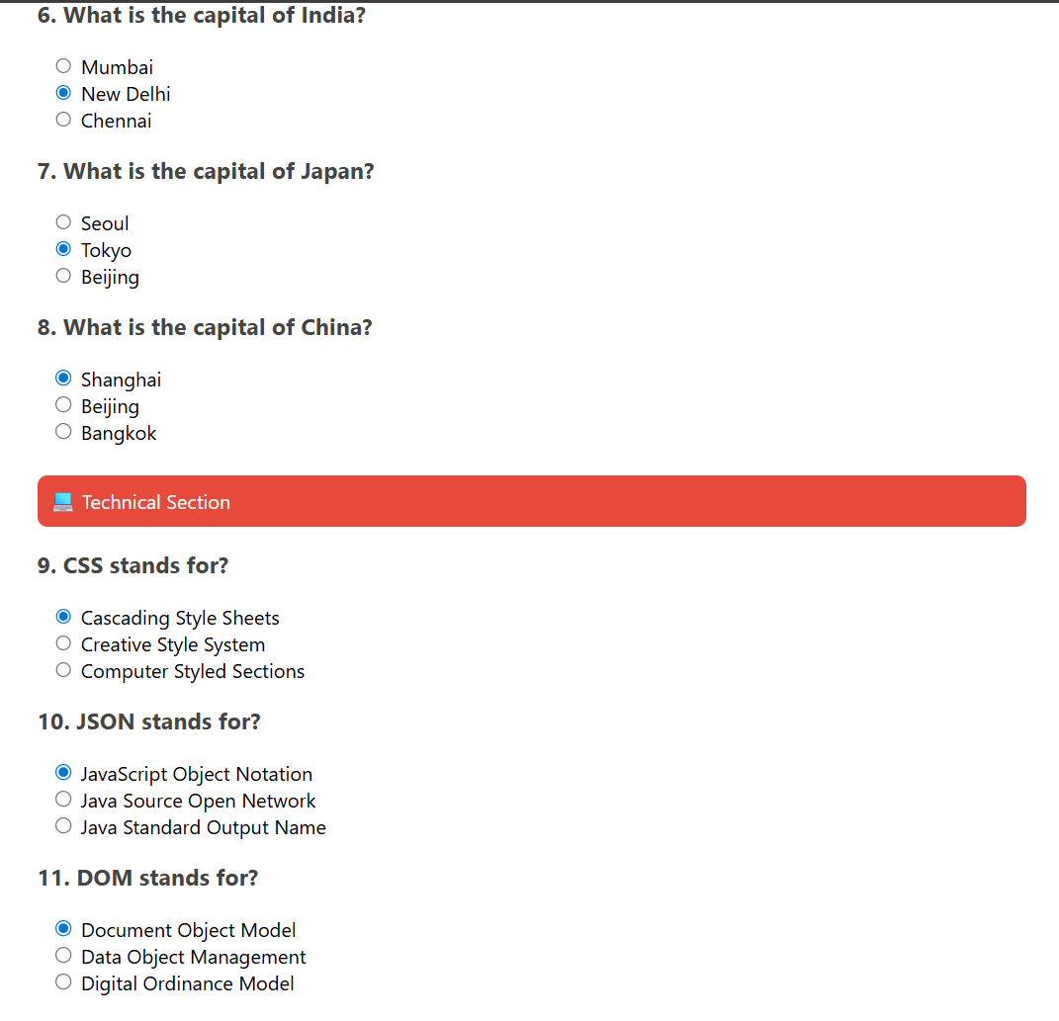
IMPLEMENTATION SCREENSHOTS
1
2
3
4
5
6
7
8(B)
9

Slide 13
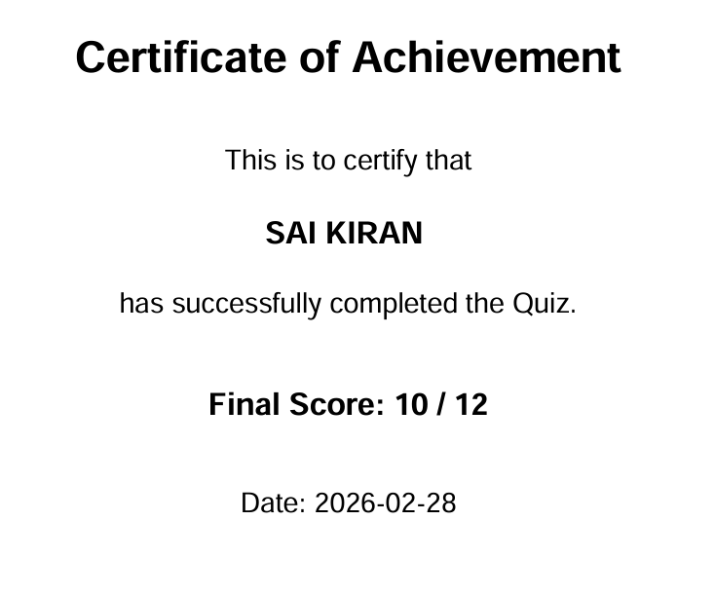
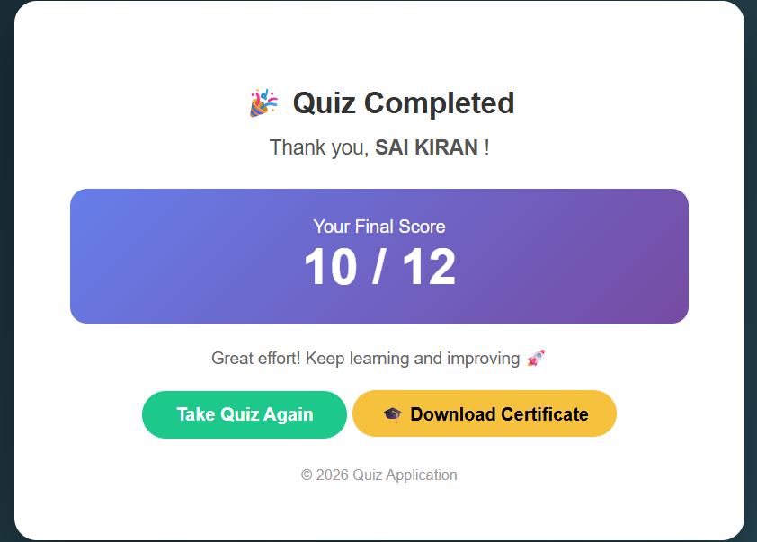
IMPLEMENTATION SCREENSHOTS
1
2
3
4
5
6
7
8(C)
9

Slide 14
ADVANTAGES & LIMITATIONS
Advantages:
1.Time saving and Fully Automated.
2.Instant Certificate Generation.
3.Easy Access & Scalable.
Limitations:
1.Limited to Objective-Type Questions.
2.Internet Dependency(Stable Internet connection is Required).
3.Security and Malpractice Issues.
4.Certificate Misuse.
1
2
3
4
5
6
7
8
9

Slide 15
Thank you

